Slide 1
EECS-731 Understanding climate change with data-science
Team Oracle
Austin Adams
Pushkar Singh Negi
Ravali Kondreddi
Ronald Moore
Waqar Ali

Slide 2
Model
Trying to predict temperature trends over next few years based on certain factors
1
Data Gathering
2
Merged dataset
Feature analysis
3
4
Classification
Clustering
Other possible findings
Outcome
Stat analysis
Anomaly detection
Forecasting

Slide 3
Introduction
What is this project about?
What is climate-change?
Factors causing temperature change
Consumption of fossil-fuels
Emission of CO₂
Population increase
Melting of polar ice-caps
Emission of Ozone depleting substances

Slide 4
Introduction
Role of Data-Science
Identify if we can correlate the trends in the identified factors over the years with climate-change trend
Use classification / clustering techniques to make predictions
Explore the occurrence of natural disasters in the last century
Correlate with climate change trend
Use time-series forecasting to predict future disaster trend

Slide 5
“ Climate change is a change in the statistical distribution of weather patterns when that change lasts for an extended period of time .”
Wikipedia

Slide 6
Data Exploration

Slide 7
Features
Sea-level rise
Coal Consumption
Oil Consumption
Co2 Concentration
Natural Gas production

Slide 8
Temperature
Timestamp
Average Land Temperature (TempLand)
Uncertainty in Average Land Temperature
Max Land Temperature
Uncertainty in Max Land Temperature
Average Land and Sea Temperature (TempGlobal)
Uncertainty in Average Land and Sea Temperature

Slide 9
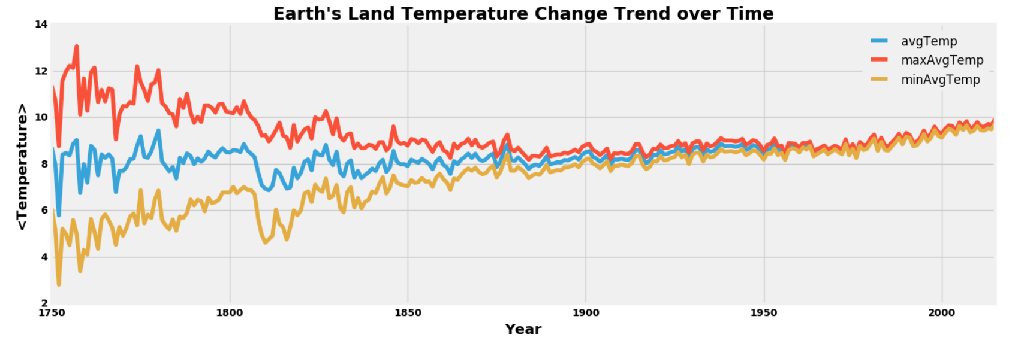
Global Temperature
Annual Trend

Slide 10
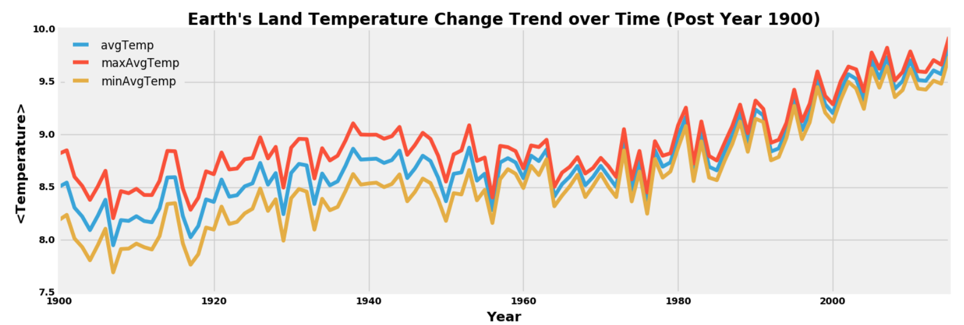
Global Temperature
Annual Trend (Last Century)

Slide 11
CO₂ Emission
Features
Year
Entity (Country Name)
Code (Country Code)
Annual CO₂ Emission (Million Tonnes)
Strategy
Aggregate values on a per-year basis across all entities

Slide 12
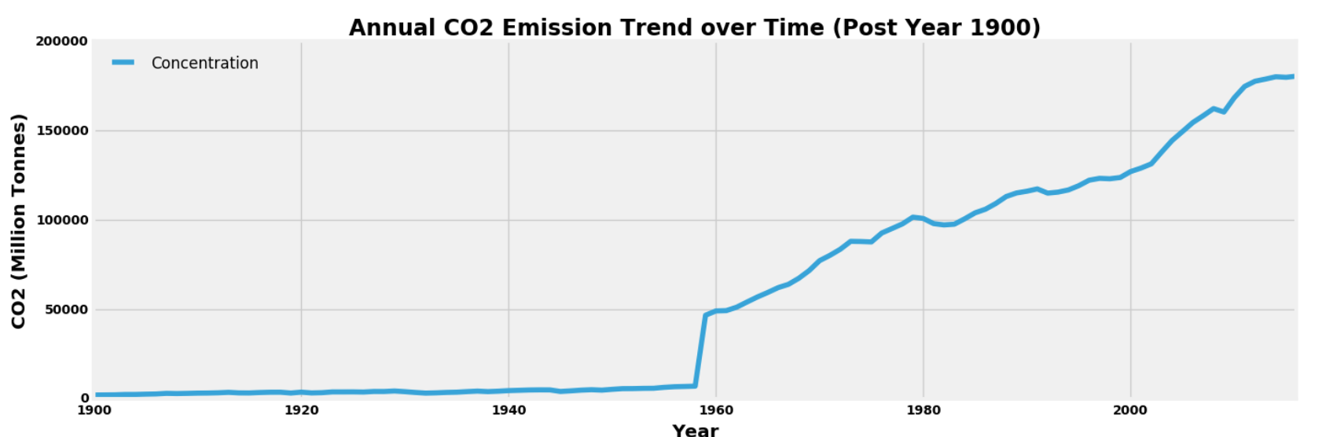
CO₂ Emission
Annual Trend (Last Century)

Slide 13
Sea-Level rise
Features
Year
GMSL (Global mean sea level)
GMSL Uncertainty
Units : Millimeter
Strategy
Aggregate values on a per-year basis across all entities

Slide 14
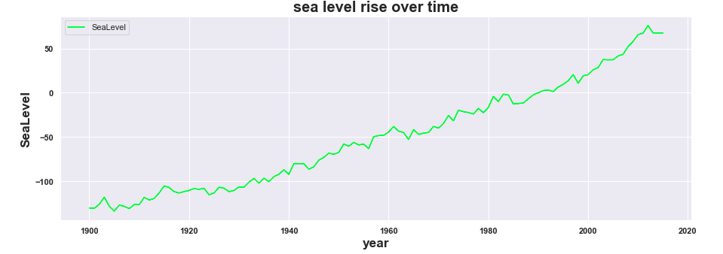
Sea-Level rise
Annual Trend(Last Century)

Slide 15
OIL
Features

Slide 16
OIL
Annual Trend(Last Century)

Slide 17
COAL
Features

Slide 18
COAL
Annual Trend(Last Century)

Slide 19
GAS
Features

Slide 20
GAS
Annual Trend(Last Century)

Slide 21
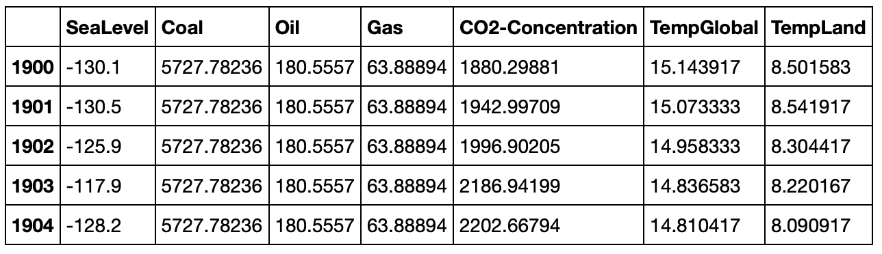
Merged dataset
Features
Notes:
Replace this snapshot

Slide 22
Clustering

Slide 23
Template
Subtext
Body/bullet text with no bullet icon

Slide 24
ClAssification

Slide 25
Template
Subtext
Body/bullet text with no bullet icon

Slide 26
Anomaly Detection

Slide 27
Anomaly detection
Detecting outliers in the data
Used to identify unusual patterns in data
Plot anomalies between year and each feature
Isolation forest
Isolation forest measure the outlierness of a point by determining how long it takes to isolate that point
Isolation Forest

Slide 28
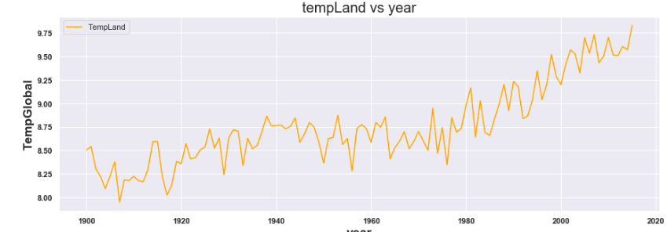
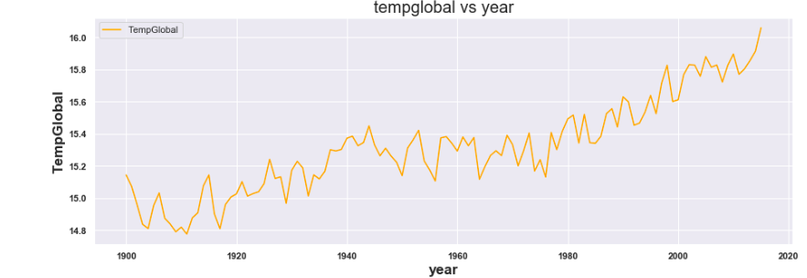
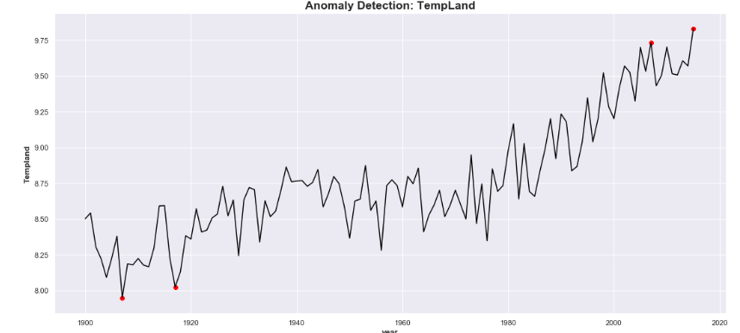
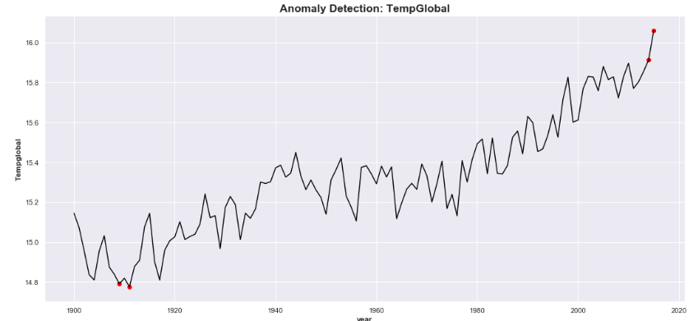
Anomaly plots
Land Temperature
Global temperature
Land temperature anomalies
Global temperature anomalies

Slide 29
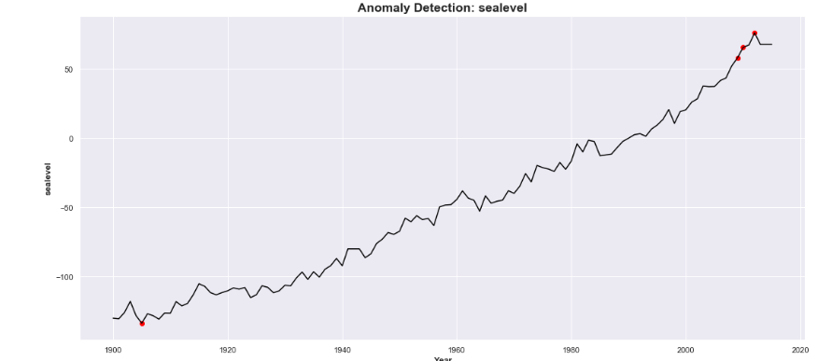
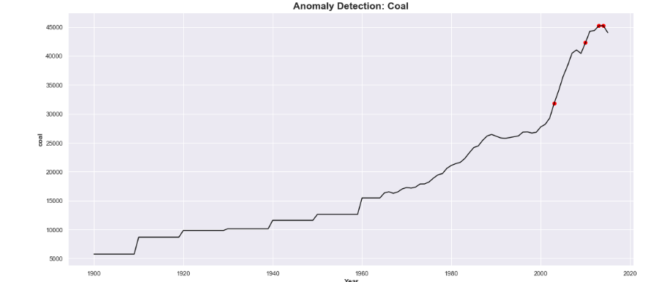
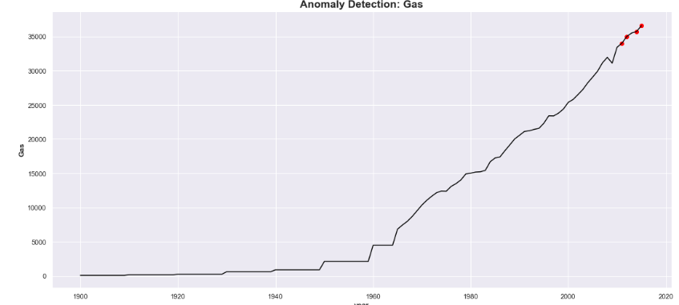
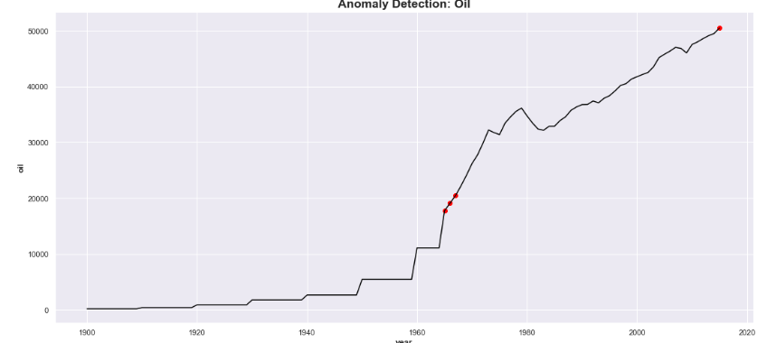
Anomaly Plots
SEA_LEVEL
COAL
GAS
OIL
In 2015 oil and gas might have contributed more to temperature change

Slide 30
Statistical Analysis

Slide 31
Template
Subtext
Body/bullet text with no bullet icon

Slide 32
Natural Disasters

Slide 33
Template
Subtext
Body/bullet text with no bullet icon

Slide 34
ConClusion

Slide 35
Learning outcomes
EECS-731
Body/bullet text with no bullet icon

Slide 36
Questions?

Slide 37
Multi-image layout 4up
Title with images
Title Goes Here
Supporting text here
Title Goes Here
Supporting text here
Title Goes Here
Supporting text here
Title Goes Here
Supporting text here

Slide 38

title
Subtitle
Text goes here
Text goes here
Text goes here
Text goes here

Slide 39

Imagery, chart and text
Subtitle
Use body text sparingly on slide types that include other information, such as, an image and data/chart. Too much on the slide might be hard for the viewer to take in.

Slide 40
“ Quoted text example goes here. Trebuchet, 42 pt. Use with shorter (headline type) quotes.”
Quote Source, Trebuchet 16 pt

Slide 41
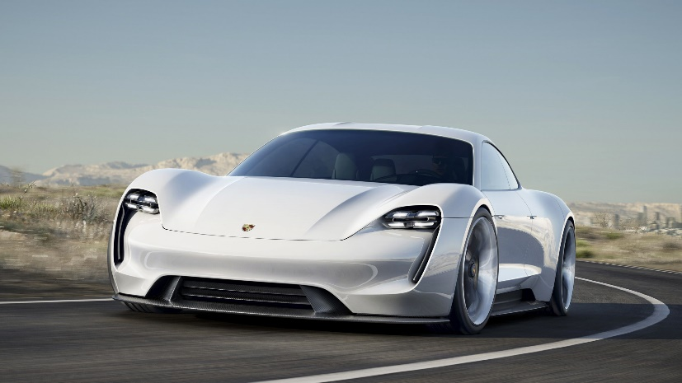
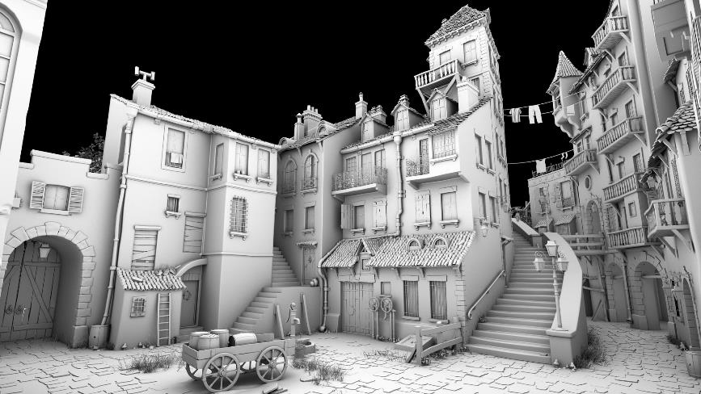


Timeline with images
Text Goes Here
Text Goes Here
Text Goes Here
Text Goes Here
xxxx
xxxx
xxxx
xxxx
Source: Source information is 8 pt, italic

Slide 42
World map
<Explanation>
Helsinki
Santa Clara
Tokyo

